Slide 1
CS 4530: Fundamentals of Software Engineering
Module 13: Software Engineering & Security
Adeel Bhutta and Mitch Wand
Khoury College of Computer Sciences
© 2026, released under CC BY-SA

Slide 2
Learning Objectives for this Module
By the end of this module, you should be able to:
  Define key terms relating to software/system security
  Explain 5 common vulnerabilities in web applications and similar software systems, and describe some common mitigations for each of them.
  Explain why software alone isn’t enough to assure security
  Explain at least one way in which security can be incorporated into an agile development process

Slide 3
Outline of this lecture
Definition of key vocabulary
Some common vulnerabilities, and possible mitigations
Getting security right is about people as well as software.
Notes:
<Read slide>
Part 2 is the largest portion of the lecture.

Slide 4
Security: Basic Vocabulary (1)
Security is a set of non-functional requirements (sometimes called “CIA”):
Confidentiality: is information disclosed to unauthorized individuals?
Integrity: is code or data tampered with?
Availability: is the system accessible and usable?
Notes:
Security is often considered a broad non-functional requirement: systems are expected to be “secure”. But as we’ll see in this lecture, security covers a range of different security requirements. Here are three common security requirements.
Confidentiality - is information disclosed to unauthorized parties?
Integrity - is our code or data tampered with, at rest, or in transit
Availability - Can someone prevent my system from otherwise functioning? note that leaving something unplugged solves confidentiality and integrity :)
Discussion: Think about recent examples of security events and how they violated these properties

Slide 5
Security: Basic Vocabulary (2)
Asset: something of value that is the subject of a security requirement
Threat: potential condition or event that could compromise a security requirement
Vulnerability: a characteristic or flaw in system design or implementation, or in the security procedures, that, if exploited, could result in a security compromise

Slide 6
Security: Basic Vocabulary (3)
Attack Surface: a portion of the system that might contain a vulnerability
Exploit: a technique or method for exploiting a vulnerability
Attack: an event that results in the realization of a threat
Mitigation: a technique for making an attack less likely, more expensive, or less valuable to an attacker.

Slide 7
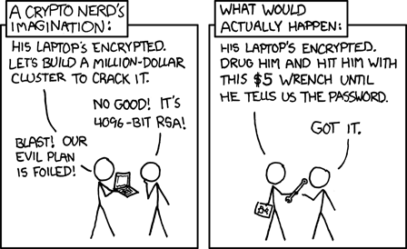
Security is a multiplayer game
The threat model specifies the rules you imagine that the other person is playing by
GameNite has radically different applicable threat models than, say, the State Department.
The attack surface is where the other player gets to play the game
https://xkcd.com/538/

Slide 8
A Simple Threat Model
Simple threat model and attack surface: on the web, an attacker can make arbitrary requests to any API endpoint, send arbitrary messages over websockets, and can directly interpret every message that comes from the server.
Mitigations:
Don't put secrets in client code
Aggressively validate API requests
  more on this later.
Notes:
Here is a very simple threat model that we will use for this module.

Slide 9
Security Principle #1: Minimize Attack Surfaces
Mitigations:
  Study new APIs and commands for new attack surfaces
  Remove extraneous dependencies
  Remove unneeded APIs and commands
  Authenticate users of APIs

Slide 10
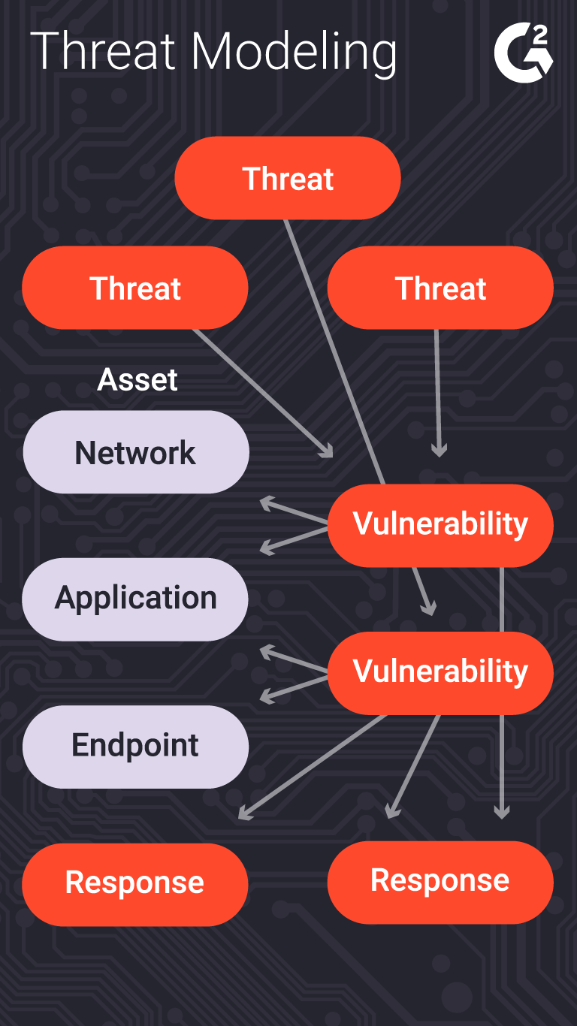
More complex systems require more complex threat models
What is being defended?
What malicious actors exist and what attacks might they employ?
What value can an attacker extract from a vulnerability?
Who do we trust? What parts of the system do we trust?
What can we do in case of attack?
Notes:
The process of considering the potential risks, and ”non risks”, or trusted actors/components, is called “threat modeling”.
This is typically a structured process in which an organization analyzes questions like:
(read slide)
Of course, creating a threat model is not a one-time event. The model will need to be continually revised during the development process as the system is refined, and after deployment as the environment changes.
Of course there’s a whole ecosystem of consultants to help with this process.

Slide 11
STRIDE Framework can help identify Common Threats
The STRIDE framework is a useful categorization of common threats
  Spoofing
  Tampering
  Repudiation
  Information Disclosure
  Denial of Service
  Elevation of Privilege
Notes:
<read slide>

Slide 12

Security isn't always free
In software, as in the real world…
You just moved to a new house, someone just moved out of it. What do you do to protect your belongings/property?
What are the assets that need protection?
  residents, furniture, cash, your stuff
What are the vulnerabilities?
  doors, windows
Notes:
Before getting into software security, let’s talk a bit about physical security. Imagine that you have just moved to a new house, and someone just moved out. Are there things that you would want to do to secure your belongings?
For instance - do you change the locks? Maybe you are concerned that the former tenant still has keys.
(Walk through example, then ultimately point out that you live in a house with lots of glass)

Slide 13
Beginnings of a threat model for the new home: what are the costs?
Threat/Exploit | Mitigation
Fire | Smoke alarm, fire extinguisher
Hurricane | Strengthen windows; raise house; move away
Burglary | Burglar alarm? Better locks? Strengthen windows?
Former owner has keys | Change locks
Terrorism | ???
Nuclear war | ????
???

Slide 14
Five major classes of vulnerabilities
Vulnerability 1: Code that runs in an untrusted environment
Vulnerability 2: Untrusted Inputs
Vulnerability 3: Bad authentication (of both sender and receiver!)
Vulnerability 4: Malicious software from the software supply chain
Vulnerability 5: Failure to apply security policy.
https://owasp.org/Top10/2025/
Notes:
Here are 5 general classes of vulnerabilities. For each vulnerability, we will look at possible exploits and possible mitigations.
An unfortunate recurring theme that we will see in these defenses is that there is no silver bullet. An extremely motivated attacker (say, a nation-state like the US, China, or Russia) can likely, with enough time and resources, break into anything. But, we will see what we can do to increase the cost of that attack.

Slide 15

Vulnerability 1 Example: authentication code in a web application
function checkPassword(inputPassword: string){
if(inputPassword === 'letmein'){
return true;
}
return false;
}
Front End
Curses! Foiled Again!
User controls this
Trust boundary
Back End
Fix: Move code to back end (duh!)
We control this
Notes:
What if we put some sensitive code in the front end of our web app? In general, there’s nothing to prevent the user from looking at the code or modifying it. Here, the correct password is sitting in plaintext where the user can find it.
That’s an extreme example, of course, but there are others: the user might be able to extract keys and other secrets from the front-end code.
The general fix to this is to move that sensitive code into our backend, which we should, hopefully, trust to faithfully execute the code.
Another example: if we have external services (like a database, or some other API, like one for accessing cloud resources), we might be tempted to distribute our database password (or key for third party API) with the application, so that it can directly connect to our database.
Our frontend might try to restrict what data the user can access, but because the user can also use these credentials to directly connect to our database, they will have the power to do whatever is permitted for those credentials.
(Professor Wand says: yes, this animation is cheesy, but I had way too much fun doing it).

Slide 16
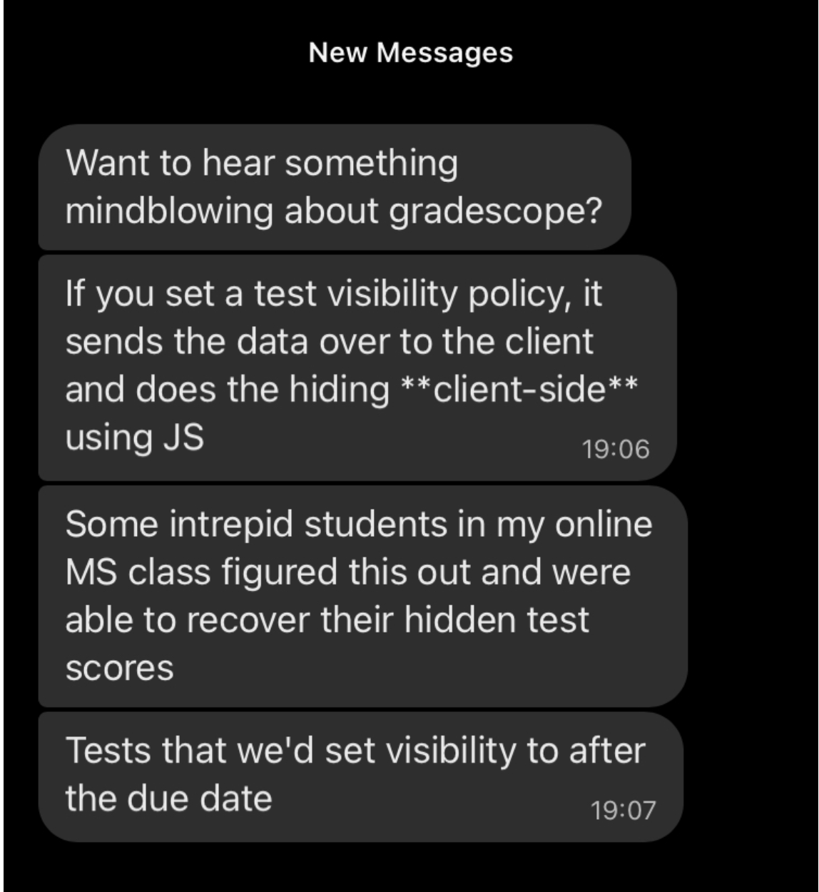
Who would do such a silly thing?
Notes:
<click>
Answer: Gradescope!

Slide 17
Vulnerability 2: Data controlled by a user flowing into our trusted codebase
https://xkcd.com/327/
Notes:
The next class of threat that we will consider is: untrusted user inputs. Imagine that we have solved our problem of “do we trust where the code runs” by running that code on our own server that we control. Surely, we still receive inputs from users, who we should not trust.
Here is a pop-culture reference from XKCD that makes fun of this class of threat

Slide 18
Example: code injection
String query = "SELECT * FROM accounts WHERE
name='" + request.getParameter(“name") + "'";
Parameter name | Constructed Query | Effect
Alice | SELECT * FROM accounts WHERE name=‘Alice’; | Select a single account
Alice O’Neal | SELECT * FROM accounts WHERE name=‘Alice O’Neal’; | SQL Error
5’ OR ‘1’=‘1 | SELECT * FROM accounts WHERE name=‘5’ OR ‘1’=‘1’; | Select all accounts
OOPs!
OWASP https://owasp.org/Top10/2025/A05_2025-Injection/
Notes:
Here’s a real example. By putting in a suitably crafted query into an innocuous-looking query, a user could select ALL accounts in the database. This is number 3 in the OWASP list of most common vulnerabilities (the link is on the slide, and also in the resources links for this lecture). OWASP stands for the Oen Web Application Security Project.

Slide 19
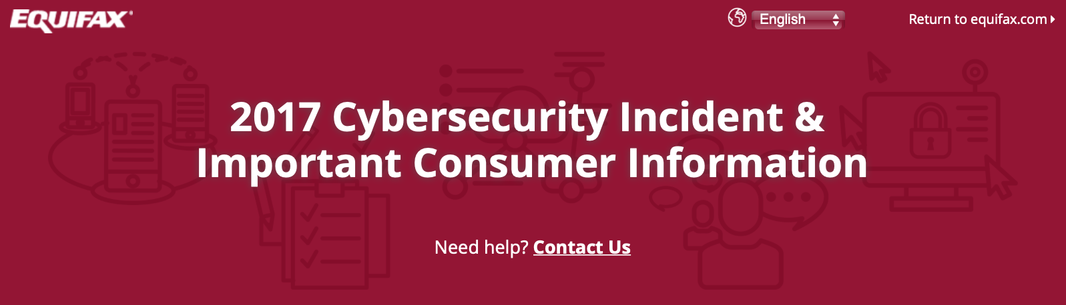
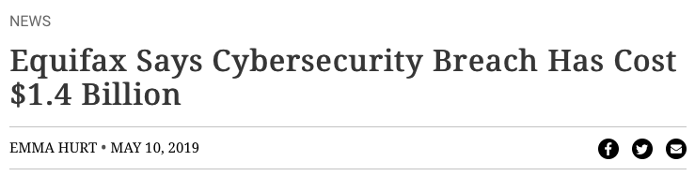
A code injection attack (in Apache struts) cost Equifax $1.4 Billion
CVE-2017-5638 Detail
Current Description
The Jakarta Multipart parser in Apache Struts 2 2.3.x before 2.3.32 and 2.5.x before 2.5.10.1 has incorrect exception handling and error-message generation during file-upload attempts, which allows remote attackers to execute arbitrary commands via a crafted Content-Type, Content-Disposition, or Content-Length HTTP header, as exploited in the wild in March 2017 with a Content-Type header containing a #cmd= string.
Notes:
For example: the Equifax data breach in 2017 that has thus-far cost the firm over 1.4 billion dollars was caused by a vulnerability in their web app, which allowed untrusted user input to flow into a part of the application that would then execute that input as java code.

Slide 20
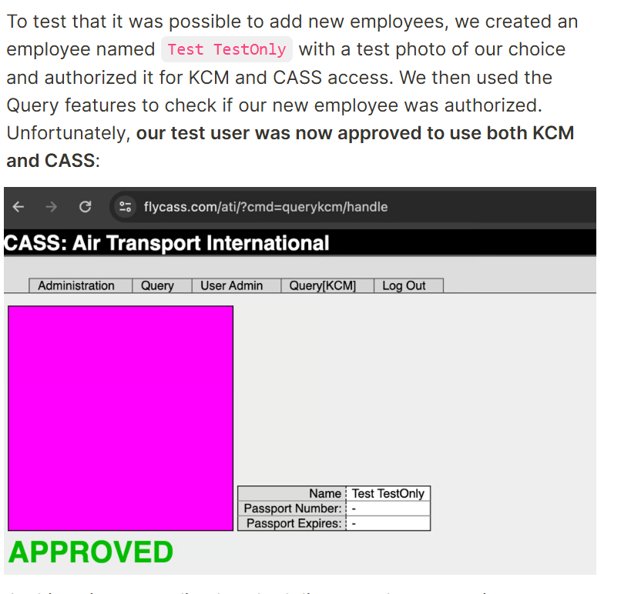
Bypassing airport security via SQL injection (2024!)
"Known Crewmembers" can get to the cockpit without inspection.
Large airlines: Each airline runs its own authorization system, but small airlines rely on a vendor
The authors found one such vendor that had an SQL injection error
Using the username of ' or '1'='1 and password of ') OR MD5('1')=MD5('1, we were able to login to FlyCASS as an administrator of Air Transport International!
OOPs!
https://ian.sh/tsa
Notes:
Followup: After the authors identified the problem, they attempted to report it. On the website they wrote:
We ended up finding several more serious issues but began the disclosure process immediately after finding the first issue.
We had difficulty identifying the right disclosure contact for this issue. We did not want to contact FlyCASS first as it appeared to be operated only by one person and we did not want to alarm them. On April 23rd, we were able to disclose the issue to the Department of Homeland Security, who acknowledged the issue and confirmed that they “are taking this very seriously”. FlyCASS was subsequently disabled in KCM/CASS and later appears to have remediated the issues.
After the issue was fixed, we attempted to coordinate the safe disclosure of this issue. Unfortunately, instead of working with us, the Department of Homeland Security stopped responding to us, and the TSA press office issued dangerously incorrect statements about the vulnerability, denying what we had discovered.

Slide 21
SE-level mitigations for code injection attacks
Use packages like Zod to sanitize inputs
  don't do this yourself!
Use eslint rules to check that Zod is used on every input flow
Avoid unsafe query languages (e.g. SQL, LDAP, language-specific languages like OGNL in java). Use “safe” subsets instead.
Avoid use of languages (like C or C++) that allow code to construct arbitrary pointers or write beyond a valid array index
Never use eval() in JS – executes a string as JS code
Notes:
Special characters like <, >, ‘, “ and ` are often involved in exploits involving untrusted inputs. So filter them, and use tools to make sure that every data flow involving user input is filtered.
Query languages might have “safe” apis and “unsafe” APIs, where the “Safe” APIs automatically perform some sanitization, allowing you to add place-holders for arguments to a query that YOU define, where the user-controlled input can ONLY flow into a specific part of the query (preventing the attacker from constructing their own query)
Don’t use “unsafe” languages like C or C++. In these languages you can write beyond a valid array index. Such buffer overflows are the primary way in which an attacker can execute arbitrary code on your app. (There are whole conferences devoted to ways of preventing this.)
And of course don’t use ‘eval’ in JS. Use a lint filter to check for this.

Slide 22
Vulnerability 3: Bad Authentication
This is mostly about password management
Attack surface:
  your password system
  the attacker may use lists of passwords stolen from other sites
Notes:
"Identification and Authentication Failures" is #7 on the 2021 OWASP Top 10 Web Application Security Risks. (See the page for this module on the course web site for URL).
i

Slide 23
(Inadequate) Mitigation: Don't keep passwords; keep their hashes instead
Cryptographic hash:
  Space of hash values is very large (NOT what you'd use for a hash table)
  hash collisions should be so rare as to be negligible
  can't go from hash code to original
Your table consists of (username, savedHash) where savedHash is the hash of the password they created when they signed up for the site.
Afterwards, the user logs in with (username, maybePassword).
You compare hash(maybePassword) vs savedHash.
Notes:
(Of course, hash codes are smaller than the thing they are hashing, so they can't possibly be 1-1, but it will be impractically hard to go from a hash code h to ANY m s.t. hash(m) = h.)

Slide 24
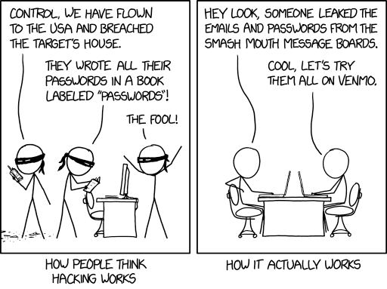
Is this good enough?
…people reuse passwords all the time. Could an attacker take advantage of that?
https://xkcd.com/2176/

Slide 25
Is it safe to store the hashes instead of the passwords themselves?
Imagine that the attacker has stolen your password db, which looks like
  (username, hashedpassword)
Next, imagine that the attacker has stolen a table that looks like
(username, password)
  this happens all the time!
So they can easily construct a table that looks like
  (username, password, hash(password))
  This is sometimes called a "rainbow table"
And now they can run a join and retrieve a table that looks like
  (username, password)
for each username that is in both tables
OOPs!
Notes:
Give it to someone else — almost always the right move for credit card numbers! But not for

Slide 26
Actual Mitigation: always salt your passwords
For each user, generate a random number called the "salt"
  typically 128 bits (16 bytes)
Your password db should now look like
  (username, salt, hash(password+salt)
There's no connection between hash(password+salt) and hash(password)
So the rainbow table won't work.

Slide 27
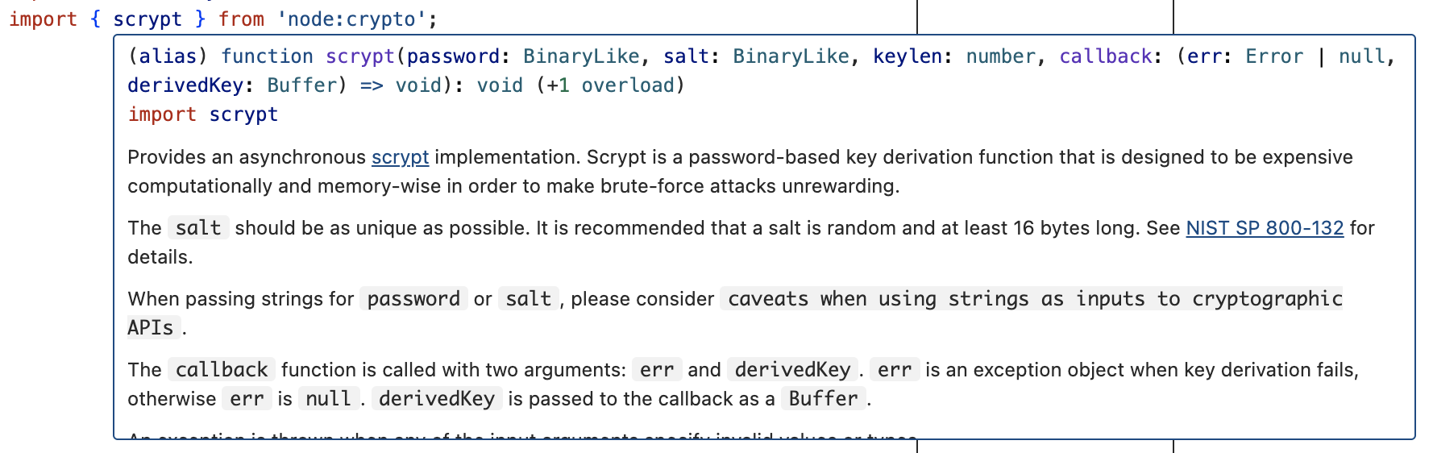
Security Principle #2: Don't try this at home; use an established solution instead
Use established, well-studied crypto packages
This is a general security principle

Slide 28
Vulnerability 4: Supply-Chain Attacks
Our code probably has lots of dependencies.
Every third-party dependency is a potetial attack surface.
Notes:
Next, let’s consider so-called software supply chain threats.

Slide 29
Third-party dependencies show up throughout the development process
External dependencies
Build process
Distribution process (including updates)
Operating environment
In-house code
Notes:
The “software supply chain” includes many potential points of weakness. We might need to consider threats at each phase of the software development and deployment process, including:
External dependencies: potential for malicious dependencies
In-house code: potential for insider attack (a developer who is either malicious, or whose laptop has been otherwise compromised through another vulnerability)
Build process: potential for build system to be compromised through another vulnerability or insider attack
Distribution process: potential for a malicious update to be pushed out to your customers
Operating environment: potential for other threats in the operating environment to result in a compromise of our software

Slide 30
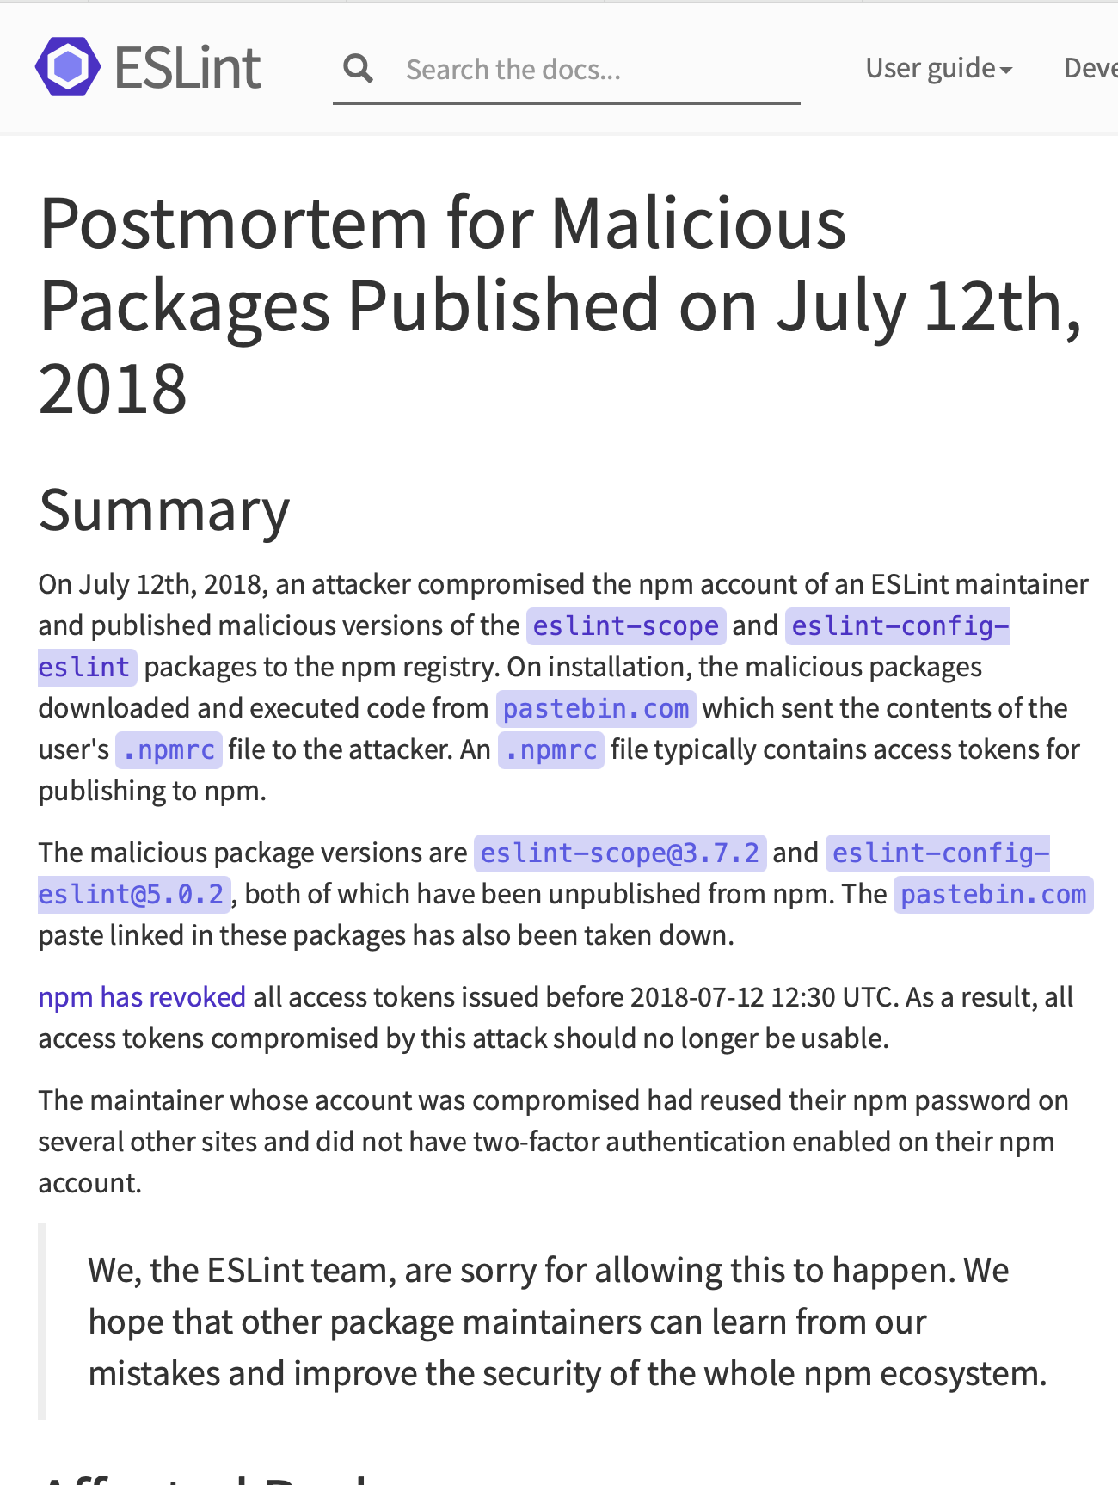
Example: the eslint-scope attack (2018)
On 7/12/2018, a malicious version of eslint-scope was published to npm.
eslint-scope is a core element of eslint, so many many users were affected.
Let’s analyze this…
https://eslint.org/blog/2018/07/postmortem-for-malicious-package-publishes/
Notes:
Let’s look at a couple of examples. In 2018, a malicious version of an eslint package called eslint-scope was published. This was a quite serious issue.
https://eslint.org/blog/2018/07/postmortem-for-malicious-package-publishes/

Slide 31
This incident leveraged several small security failures
An eslint-scope developer used their same password on another site.
The other site did not use 2FA
Password was leaked from the other site.
Attacker created malicious version of eslint-scope
Many users did not use package-lock.json, so their packages automatically installed the new (evil) version.
The malicious version sent copies of the user’s .npmrc to the attacker. This file typically contains user tokens.
Estimated 4500 tokens were leaked and needed to be revoked.
Notes:
Let’s look at the sequence of events, as explained in the post-mortem report on the preceding slide.
<Read Slide>
Discuss: how many violations of good security practices do you see here?
The developer used the same password on two different sites
The other site did not use 2FA
The other site did something else that allowed the password to leak.
Users did not protect their packages against silent version updates.

Slide 32
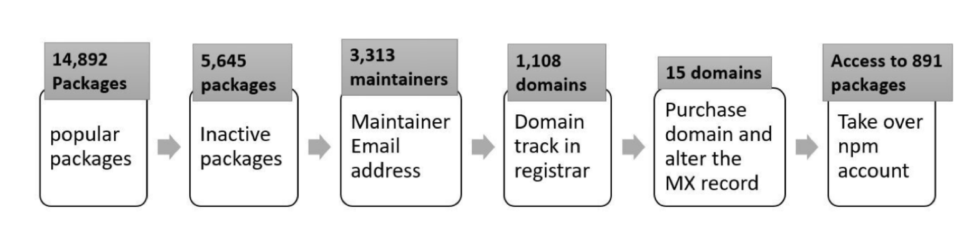
A 2021 NCSU/Microsoft found that many of the top 1% of npm packages had vulnerabilities
Package inactive or deprecated, yet still in use
No active maintainers
At least one maintainer with an inactive (purchasable) email domain
Too many maintainers or contributors to make effective maintenance or code control
Maintainers are maintaining too many packages
Many statistics/combinations: see the paper for details.
“What are Weak Links in the npm Supply Chain?” By: Nusrat Zahan, Thomas Zimmermann, Patrice Godefroid, Brendan Murphy, Chandra Maddila, Laurie Williams https://arxiv.org/abs/2112.10165
Notes:
Here is a list of significant vulnerabilities found in the most popular packages (“top 1%”).

Slide 33
Your suppliers' risks are your risks
"Known Crewmembers" can get to the cockpit without inspection.
Large airlines: Each airline runs its own authorization system, but small airlines rely on a vendor
The authors found one such vendor that had an SQL injection error
Using the username of ' or '1'='1 and password of ') OR MD5('1')=MD5('1, we were able to login to FlyCASS as an administrator of Air Transport International!
OOPs!
https://ian.sh/tsa
Notes:
The problem with supply-chain vulnerabilities is that they are recursive! Your suppliers' risks easily become your risks.

Slide 34
Your suppliers' risks are your risks.
MOVEit is a file transfer program owned by Progress Software.
Over 2500 organizations used the program to move sensitive personal data.
They were attacked in May 2023.
Prof. Wand says: my bank didn't use MOVEit, but they used a supplier who did.
Now, they have to take expensive steps to offer me identity-protection services, etc.
Notes:
Prof. Wand says: I received two letters like this from two of my financial institutions within a week.

Slide 35
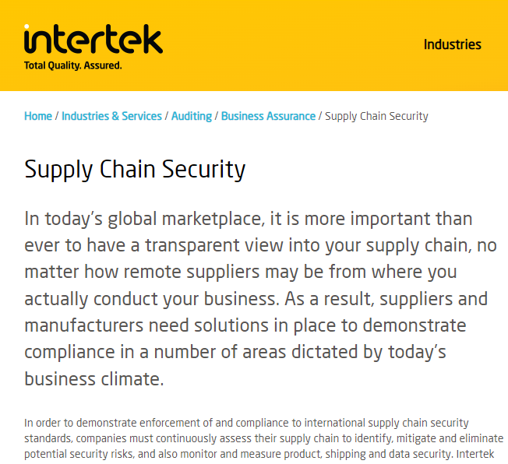
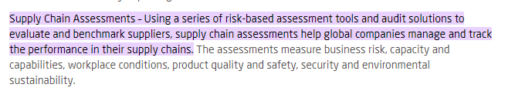
Supply-chain risks include more than just software.
Notes:
Of course, supply-chain security risks include more than just software. Your suppliers are subject to regulatory risks, transportation risks, etc, etc. Will your supplier in West Arstotzka (*) be taken over by the government, or overrun by mercenaries or rioters?
So of course there are consultants to help you manage all that. Here’s the web page of one such firm. (found after 30 seconds of googling)
[* Arstzoska is the name of a fictional country I found on Wikipedia]

Slide 36
Process-level Threat Mitigations
External dependencies
  Audit all dependencies and their updates before applying them
In-house code
  Require developers to sign code before committing, require 2FA for signing keys, rotate signing keys regularly
Build process
  Audit build software, use trusted compilers and build chains
Distribution process
  Sign all packages, protect signing keys
Operating environment
  Isolate applications in containers or VMs
Notes:
While we could easily solve problems in our own code by bolting on some useful additional components (like using SSL), it’s not so easy to solve threats to our software supply chain process – there need to be process-based solutions for these process-based problems.
These kinds of threats are currently some of the most-talked about (and most feared) because they are complex to defend against.
For example: how do we audit dependencies? Who does that, and when? What is “secure enough” for a dependency?
Who loves needing to do 2FA for every time you sign into canvas? How much worse is it if you had to do it for each git commit?
Signatures are useful only insofar as we trust the signer. If a developer’s computer is compromised (say, through a phishing attack), what good is that signature? Same for distribution.
Perhaps the best news-you-can-use here is to isolate each application in its own container or VM, reducing the scope of security breaches to be isolated within that environment and not directly impacting other applications.

Slide 37
Vulnerability #5: Failure to Apply Security Policies
Remember the outline of our lecture:
Definition of key vocabulary
Some common vulnerabilities, and possible mitigations
Getting security right is about people as well as software.
Notes:
This brings us to the third item in our outline (from way back on slide 3)

Slide 38
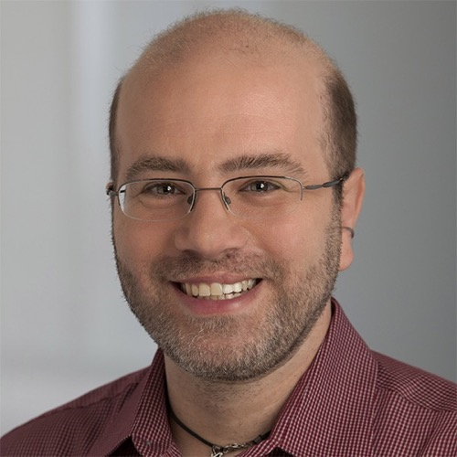
David Blank-Edelman (former head of Systems at Khoury)
“The solution is in front of the screen, not behind it”
Notes:
As David Blank-Edelman(*) used to say: “the solution is in front of the screen, not behind it.”
(*) former head of Systems at Khoury

Slide 39
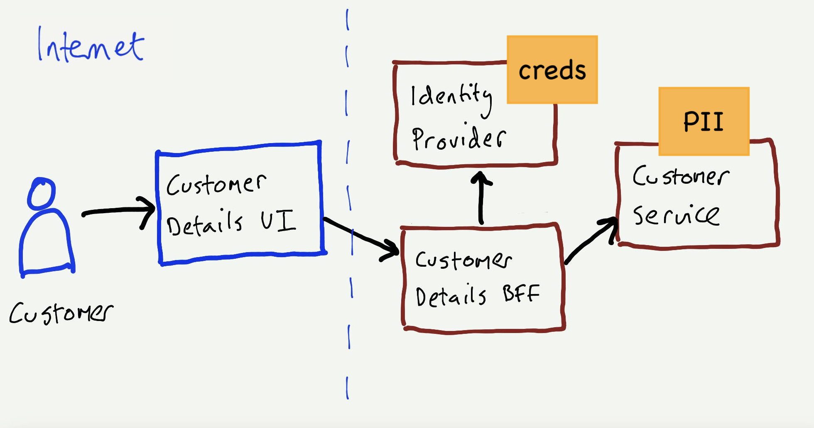
Security Principle #3: Every data flow is an attack surface
There may be vulnerabilities on each flow.
  Customer -> UI
  Customer -> Identity Service
  UI -> BFF
  BFF -> Customer Service
Notes:
<read slide>

Slide 40
Systematically review security needs on each attack surface
Collaborate with stakeholders to understand security needs for each data flow and identify the most vulnerable of them.
Frequent and small iterations
  Start with the thinnest slice of the system. e.g.,
    User registration flow
    A microservice and its collaborating services
    Current iteration
  Repeat and refine them.
Make this a regular part of the overall QA process
Notes:
Now let's start on our final topic… <Read Slide>

Slide 41
For every data flow, ask “what could go wrong?”
Spoofed identity: Is there Authentication? Should there be? - Attackers pretending to be legitimate users through stolen credentials, phishing, or social engineering.
Tampering with input: What about nasty input? - Attackers modifying data, code, or memory maliciously to break your system's trust boundaries.
Repudiation: Does the system show who is accountable? - When something goes wrong, can you prove which user performed an action, or could they plausibly deny responsibility due to insufficient audit trails?
Information disclosure: Is sensitive data inappropriately exposed or unencrypted? - Unauthorized access to sensitive data through poor access controls, cleartext transmission, or insufficient data protection.
Denial of service: What if we smash it? - Attacks aiming at making the system unavailable to legitimate users by flooding or breaking critical components.
Elevation of privilege: Can I bypass Authorization? Move deeper into the system? - Attackers gaining unauthorized access levels, obtaining higher permissions than intended, or moving laterally through your system.

Slide 42
Choose highest priority vulnerabilities
Add Highest Priority threats to backlog (as user stories or conditions of satisfaction)
Given the user is logged in
When they request to view their profile page And they have a valid token
Then their profile page is displayed
Given the user is logged in
When they request to view their profile page
But they do not have a valid token
Then they are asked to login or signup
Notes:
<read slide>

Slide 43
What are you going to do?
Prioritize and Fix
  Aim to address manageable number of threats (e.g., 3)
Examples:
  Authorization bypass when accessing an API.
  XSS attack via user input.
  Denial of service from the internet
Repeat and refine!
A Guide to Threat Modeling by Jim Gumbley: https://martinfowler.com/articles/agile-threat-modelling.html
Notes:
<read slide>

Slide 44
Learning Objectives for this Module
You should now be able to:
  Define key terms relating to software/system security
  Explain 5 common vulnerabilities in web applications and similar software systems, and describe some common mitigations for each of them.
  Explain why software alone isn’t enough to assure security
  Explain at least one way in which security can be incorporated into an agile development process

